Slide 1

A02 A Comparative Analysis of Machine Learning and Deep Learning Tools and Frameworks
Department of Science, Technology, Engineering & Math
Team 5
Contributors: Martin Demel, Bradley Johnson, Jesus Ocampo, Ethan Phan
January 29th, 2025

Slide 2
Agenda
Introduction
History
Real World Applications
Demonstration
Spacy
NLTK
Conclusion
Sources

Slide 3

Introduction
What is NLP
Natural Language Processing (NLP) enables computers to understand, interpret, and generate human language.
Importance of NLP Tools
As text data grows exponentially, robust NLP libraries are essential for tasks like sentiment analysis, information extraction, and language modeling.
Presentation Goal
Provide a clear overview and comparison between NLTK and spaCy.
Focus NLTK vs. SpaCy
NLTK is a pioneering toolkit well-known in academia for teaching and prototyping
SpaCy is a newer, production-oriented library known for its speed and efficiency.

Slide 4
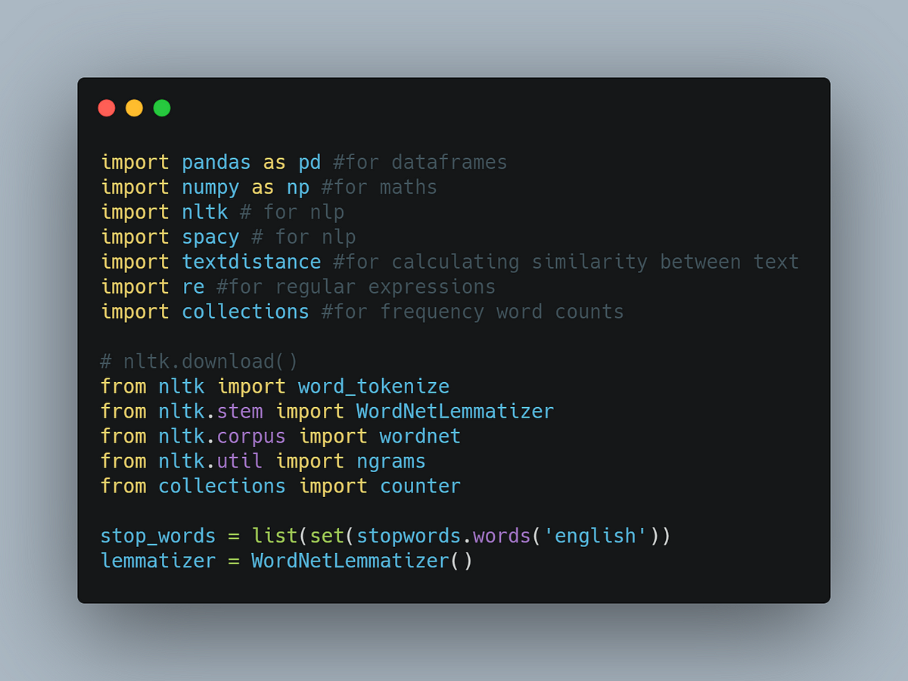
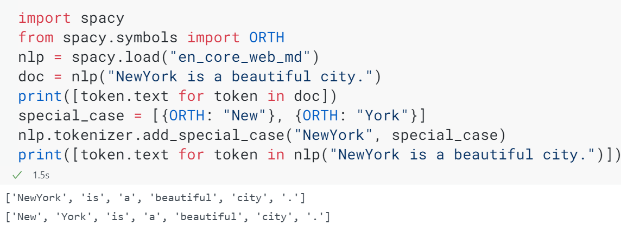
A Brief History
NLTK
Origin & Development
Developed at the University of Pennsylvania in 2001.
Created to support teaching and research in computational linguistics
Purpose
Offers a broad range of text processing libraries for both symbolic and statistical NLP.
Ideal for academic use, learning, and rapid prototyping.
SpaCy
Origin & Development
Developed by Explosion AI, first released in 2015
Designed for industrial-strength NLP tasks.
Purpose
Emphasizes speed, efficiency, and scalability
Well-suited for production environments and large-scale text processing.

Slide 5

Real World Applications
NLTK
Academic Research & Teaching
Widely adopted in universities for hands-on NLP assignments, projects, and demonstrations.
Used in MOOCs (Massive Open Online Courses) for illustrative NLP examples.
Prototyping & Exploratory Analysis
Ideal for quick proof-of-applications
Frequently cited in NLP-related research papers for its extensive library of linguistic tools.
SpaCy
Enterprise & Industry Use:
Deployed by companies for large-scale text analytics, including named entity recognition (NER) and information extraction.
Integrates seamlessly with machine learning pipelines for production-ready solutions.
High-Performance Applications
Popular for building efficient NLP-driven services such as chatbots and recommendation systems.
Recognized for its speed and scalability in demanding real-time processing scenarios.

Slide 6
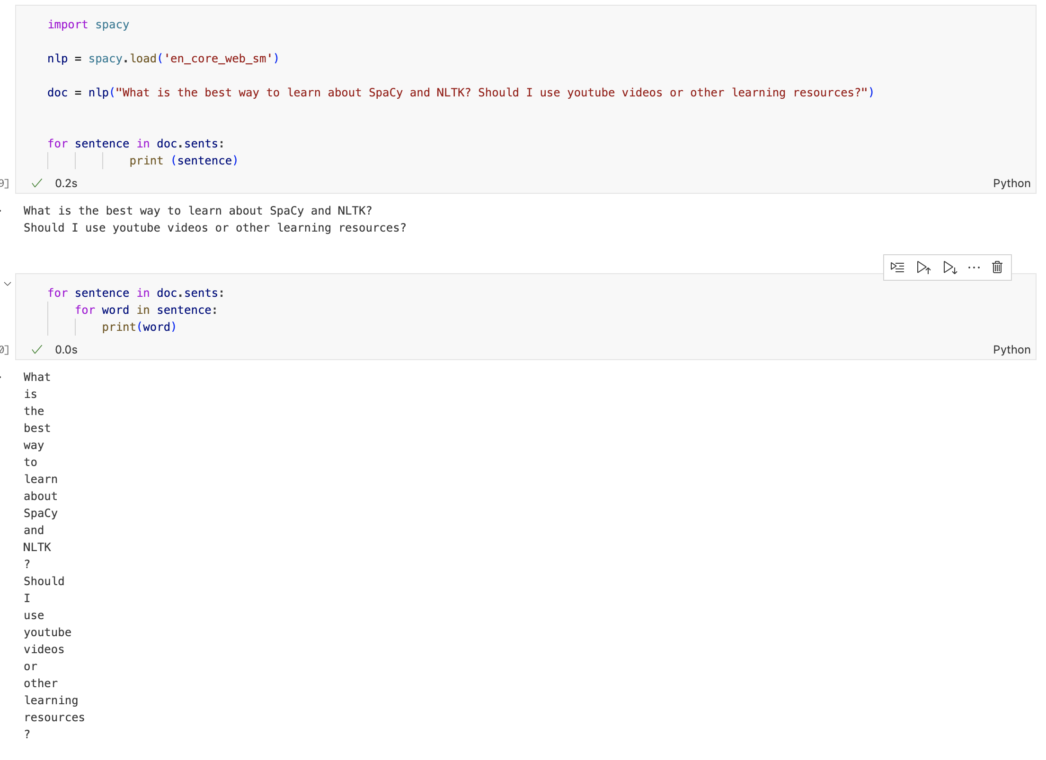
Demonstration SpaCy
For the SpaCy demonstration, we processed the text by splitting it into sentences and tokens. First, we converted the text into a Doc object using the English model. Then, we separated it into sentences, which were further broken down into tokens—words and punctuation. This showcased basic NLP tasks like sentence segmentation and tokenization.

Slide 7
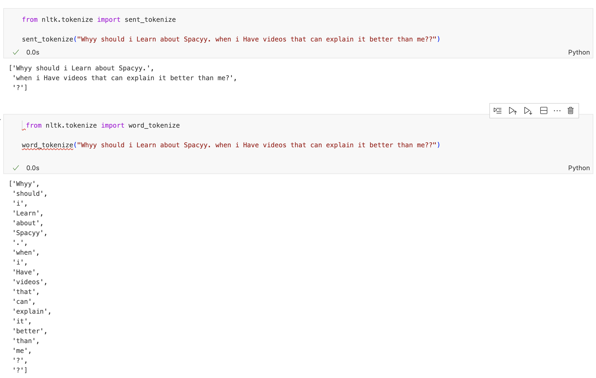
Demonstration NLTK
For the NLTK demonstration, we used the sent_tokenize function to split the input text into sentences, producing a list with each sentence as a separate element.
Furthermore, we have applied the word_tokenize function, which splits it into individual tokens. The output shows a list of tokens for possible further analysis.

Slide 8
Conclusion
While SpaCy and NLTK are excellent choices for Natural Language Processing, they are meant for different use cases. NLTK is heavily used in academic settings, is great for learning and research, and offers a wide variety of customization, making it a perfect option for anyone who requires deep customization.
Spacy, first introduced in 2015, is designed for large-scale projects. Its ability to quickly handle high volumes of text makes it a popular choice for businesses requiring reliable, real-time NLP applications.
Comparing NLTK and Spacy could be interpreted as string vs. object-oriented programming, as SpaCy utilizes classes and objects, such as Doc, Token, and Span objects.
Ultimately, deciding between Spacy and NLTK depends on performance requirements and project complexity.

Slide 9
Sources
GeeksforGeeks. (2022, September 16). Tokenization Using the Spacy library. GeeksforGeeks. https://www.geeksforgeeks.org/tokenization-using-spacy-library/
GeeksforGeeks. (2024, May 1). Introduction to NLTK: Tokenization, stemming, lemmatization, POS tagging. GeeksforGeeks. https://www.geeksforgeeks.org/introduction-to-nltk-tokenization-stemming-lemmatization-pos-tagging/
1. Language Processing and Python. (2024). https://www.nltk.org/book/ch01.html
Nathan, P. (2024, June 28). Natural language processing in Python using spaCy: An introduction. https://domino.ai/blog/natural-language-in-python-using-spacy
Extractive Automatic Text Summarization using SpaCy in Python & NLP. (2021, March 4). IEEE Conference Publication | IEEE Xplore. https://ieeexplore.ieee.org/document/9404712
Extractive Automatic Text Summarization using SpaCy in Python & NLP. (2021, March 4). IEEE Conference Publication | IEEE Xplore. https://ieeexplore.ieee.org/document/9404712

Slide 10
Thank you.

